Slide 1
A Visual Attention‑Based Model for Bengali Image Captioning Bidyut Das · Ratnabali Pal · Mukta Majumder4 · Santanu Phadikar · Arif Ahmed Sekh
Submitted by
Arpita Roy
ID: 23266026
Department of CSE
BRAC University
Submitted to
Annajiat Alim Rasel
Senior Lecturer
Department of CSE
BRAC University

Slide 2
Introduction
Image captioning involves converting a given image into a textual description.
Bengali stands as the fifth most widely spoken language globally.
Significant research advancements have been acknowledged in the field of image captioning with grammatically accurate and semantically meaningful Bengali sentences to describe images.

Slide 3
Image Caption Generation in English and Other Regional Languages
Earlier image caption generation concentrated on two types of methods:
Next advanced approach: attention-based encoder-decoder model.
Captioning has done in Japanese, Chinese, German, Dutch, French, Spanish, etc.
Template-based method
Retrieval based method

Slide 4
Methodology
The method primarily comprises a CNN-based encoder featuring an attention module and an RNN-based decoder.
Input: An RGB image passes through the CNN model.
Visual attention mechanism: highlight the important areas of the image.
Output: caption generation through RNN-based decoder.
Joint loss function: To learn the caption generation process.
Fig 1: The modules of the proposed system. The caption (A baby girl is standing in a park dressed as an angel). Introduced a joint learning by minimizing the total loss obtained from the visual attention loss and the decoder loss.

Slide 5
Methodology
CNN Based encoder:
Proposed InceptioV3 CNN module
Pretrained on ImageNet dataset
As input it considered 299 × 299 RGB image and have produced
2048 × 1 feature vector.
RNN-based Decoder:
Gated Recurrent Unit(GRU) used as decoder
Converted the caption into 256*1 vector using 256 dimension word embedding followed by two fully-connected layer.

Slide 6
Methodology
Joint loss:
Have used joint loss, extracted from CNN and the RNN.
The attention loss was extracted from a pre-trained CNN and RNN.
Pre-trained CNN encoder converted the input image to a 2048 × 1 vector.
Attention mechanism used the time-space relation between time (t) and spatial feature (ft).
The RNN maps the captions with visual attention by combining the feature vector and sequence.
Fig 2: Loss contains a combination of spatial loss and a temporal loss. CNN encoder provides the spatial or visual attention, and RNN decoder provides the alignment of the visual attention with the caption sentence

Slide 7
Methodology
Parameter settings:
299 × 299 RGB image was taken as input through the baseline CNN model.
Tanh layer was used to extract 2048 * 1 visualization.
This model used joint loss combined with Adam optimizer.
Used 120 epochs for training.

Slide 8
Dataset
This paper has used two datasets-
Datasets were separated into the following three sections-
Bangla Lekha Image Captions (BLIC) and
Bangla Natural Language Image to Text (BNLIT)
Training: 80% image
Validation: 10% image
Testing: 10% image

Slide 9
Evaluation Metric
BLEU evaluation metric was used.
For determining the BLEU score, a comparison was done between the number of n-grams in the generated sentence and the number of n-grams in the referenced sentence.
Different BLEU scores were measured-
BLEU 1: Unigram similarity
BLEU 2: Bigram
BLEU 3: Trigram

Slide 10
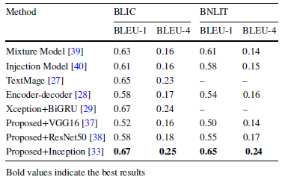
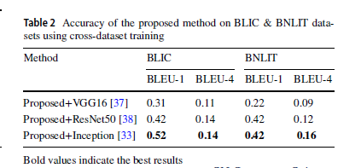
Experimental Result
The model was tested by 120 epochs with a very low rate loss of around 0.002
Table 2: Accuracy of the proposed method on BLIC & BNLIT datasets using cross-dataset training
Table 1: Accuracy of the proposed method using BLIC &
BNLIT datasets

Slide 11
Experimental Result
Fig 3: Loss over epochs during training. a Loss curve (BLIC dataset), b Loss curve (BNLIT dataset)
Fig 4: Examples of various visual attention regions generated by the proposed method along with captions

Slide 12
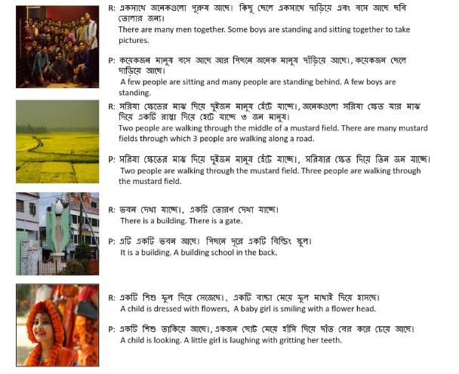
Experimental Result
Fig 5: The random images from the BLIC dataset are taken to visualize the result. R indicates the original or true captions, and P denotes the predicted or system-generated captions

Slide 13
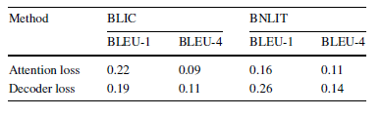
Experimental Result
This model conducted an additional ablation study by excluding attention loss and decoder loss.
The findings have indicated that the approach achieved superior performance when both losses are utilized simultaneously.
Table 3: Accuracy of the proposed method on BLIC & BNLIT datasets using different losses

Slide 14
Accomplishment, Limitation, and Future Work
Accomplishments:
Limitations:
Future work:
We have curated and benchmarked the available Bengali datasets for image caption generation by varying CNN- RNN-based encoder-decoder with an attention mechanism.
Introduced loss function.
The dataset was biased based on non-human objects.
Captions were not detailed enough.
Will have increased the BLEU score.
Will have removed the non-human object recognition biasedness towards humans.
Will have established a well-defined Bengali captioning dataset.
Email: arpita.roy1@g.bracu.ac.bd

